Slide 1
Hackathon

Slide 2
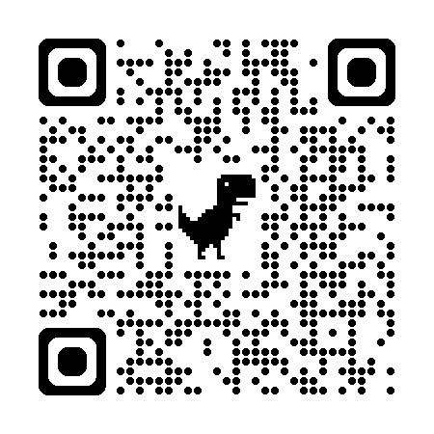
The Challenge!
https://github.com/man-group/man-imperial-algothon-2026/tree/main
We’ll release data every approximately 2h
You need to submit your allocations for each instrument before each release
Your allocations need to sum up to 1.0 and be >= 0.0
You need to maximise the out of sample sharpe (return / std)
Create a CSV named `{team_name}_round_{N}.csv`:
```csv
asset,weight
INSTRUMENT_1,0.15
INSTRUMENT_2,0.10
INSTRUMENT_3,0.05
INSTRUMENT_4,0.05
INSTRUMENT_5,0.20
INSTRUMENT_6,0.10
INSTRUMENT_7,0.15
INSTRUMENT_8,0.05
INSTRUMENT_9,0.10
INSTRUMENT_10,0.05
```

Slide 3

Momentum Signals
The idea: assets going up tend to keep going up (and vice versa)
Momentum return (lookback k):
$$r_{i,t}^{\left(k\right)} = \frac{P_{i,t} − P_{i,t−k}}{P_{i,t−k}}$$
Signal strength (vol-normalised):
$$s_{i,t} = \frac{r_{i,t}^{\left(k\right)}}{{\hat{σ}}_{i,t}}$$
Position sizing:
$$w_{i,t} = sign\left(s_{i,t}\right) · f\left(\left|s_{i,t}\right|\right)$$
Time-Series (Trend Following)
• Look at an asset's OWN past returns over a lookback window k
• AHL has been doing this since the 1980s
Cross-Sectional
• Rank assets against each other: long winners, short losers
• Market-neutral — you're betting on relative strength

Slide 4

Portfolio Construction
A good signal is only half the battle — how you BUILD the portfolio matters as much
Key decisions:
Risk budgeting — how much risk does each signal get?
Correlation — signals that always agree add no diversification
Transaction costs — the best signal is useless if it trades too much
Constraints — position limits, leverage, liquidity
Markowitz Mean-Variance Optimisation
Mean-Variance Optimisation (Markowitz):
$$\max_{w} w^{T}μ − \frac{λ}{2} w^{T}Σw$$
Constraints:
$$s.t. \sum_{i}{w_{i}} = 1, w_{i} ≥ 0$$

Slide 5
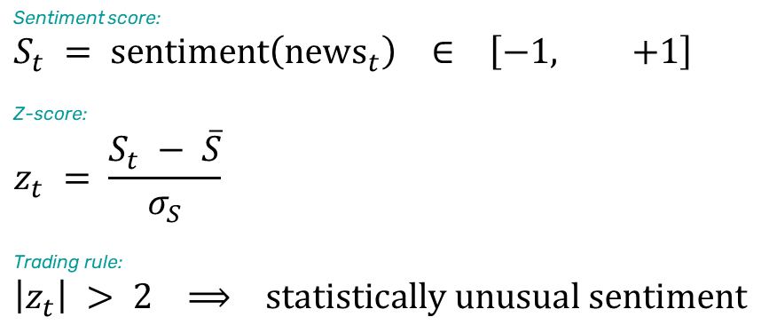
How News Moves Markets
Markets don't wait — prices react to information in seconds
The Information Cascade
• Event happens → algos parse it in milliseconds → price moves
• Humans read the headline 30 seconds later. Markets have already moved.
Quantifying Sentiment with a Z-Score
Sentiment score:
$$S_{t} = sentiment\left({news}_{t}\right) ∈ \left[−1, +1\right]$$
Z-score:
$$z_{t} = \frac{S_{t} − \overline{S}}{σ_{S}}$$
Trading rule:
$$\left|z_{t}\right| > 2 ⟹ statistically unusual sentiment$$
The key question: is this news SURPRISING? Expected news doesn't move prices.

Slide 6
Important information
This material is of a promotional nature.
This information is communicated and/or distributed by the relevant Man entity identified below (collectively the "Company") subject to the following conditions and restriction in their respective jurisdictions.
Opinions expressed are those of the author and may not be shared by all personnel of Man Group plc (‘Man’). These opinions are subject to change without notice, are for information purposes only and do not constitute an offer or invitation to make an investment in any financial instrument or in any product to which the Company and/or its affiliates provides investment advisory or any other financial services. Any organisations, financial instrument or products described in this material are mentioned for reference purposes only which should not be considered a recommendation for their purchase or sale. Neither the Company nor the authors shall be liable to any person for any action taken on the basis of the information provided. Some statements contained in this material concerning goals, strategies, outlook or other non-historical matters may be forward-looking statements and are based on current indicators and expectations. These forward-looking statements speak only as of the date on which they are made, and the Company undertakes no obligation to update or revise any forward-looking statements. These forward-looking statements are subject to risks and uncertainties that may cause actual results to differ materially from those contained in the statements. The Company and/or its affiliates may or may not have a position in any financial instrument mentioned and may or may not be actively trading in any such securities. Unless stated otherwise all information is provided by the Company. Past performance is not indicative of future results.
Unless stated otherwise this information is communicated by the relevant entity listed below.
United Kingdom: Unless indicated otherwise this material is communicated in the United Kingdom by Man Solutions Limited ('MSL') which is a private limited company registered in England and Wales under number 3385362. MSL is authorised and regulated by the UK Financial Conduct Authority (the 'FCA') under number 185637 and has its registered office at Riverbank House, 2 Swan Lane, London, EC4R 3AD, United Kingdom.

